Slide 1

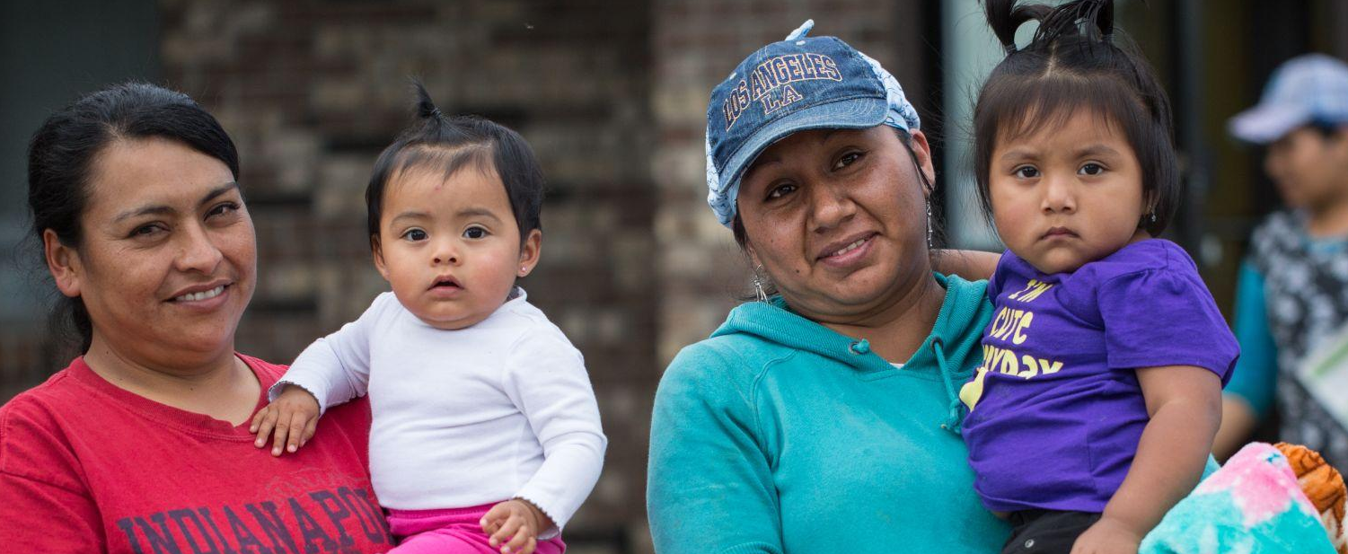

You and
Keeping Head Start Strong

Slide 2
Parents Unite what
The Parents Unite campaign is a strategic, collaborative effort to increase and elevate Head Start parents taking action and raising their voices.

Slide 3
Parents Unite how
Parents Unite will work with State and Regional Head Start Associations to strengthen our parent leaders advocacy network and efforts.
The campaign will build membership and engagement at:
NHSA’s Parent Engagement Conference and
NHSA’s Winter Leadership Institute

Slide 4
Parents Unite how
Virtual meetings will be held for parents leading up to Parents Unite April 2026 to: Inform, connect and plan.
Social media, text messaging and email will be used to improve communication and networking with parents.
NHSA’s Leadership Academy will offer training for parents on key topics: lobbying/advocacy, directors working with policy councils, etc..

Slide 5
Campaign Launch when
Nov 19. Presentation to the NHSA Board
Nov 20. Presentation to the Head Start Association Leadership
Nov 24 Email sent to Head Start community
    Presentation to NHSA staff
    Campaign is highlighted during Stand Up call
    Parents Unite landing page is published.

Slide 6
Campaign Goals Why
Create a network of Head Start parent advocates ready to continue fighting for Head Start in 2026-27.
Have Head Start parents meet with each member of Congress in April 2026 to deepen Congress’s understanding of what makes Head Start powerful.
Amplify the importance of Head Start parents and their stories to policymakers, the media, and the public, including policy influencers.
Notes:
Head Start is unique in how it involves parents as essential partners – and we want to use our voices to speak out on behalf of Head Start and our children.

Slide 7
Campaign Main Event what, who & when
During April 2026, parents from across the nation will meet with their members of congress to remind them Head Start is essential not only for Head Start families but for the nation’s future.
A select group of parents from across the country will come to Washington DC to visit with their congressional leaders April 21- 23, 2026.
In concert with the meeting in D.C., the campaign will organize parents to meet with their US Congressional Representatives at their local district offices.

Slide 8
Building Parents Unite how & who
Encourage people to go to the Parents Unite landing page to learn more about the campaign and sign up to join the campaign.
We want parents and supporters to join the campaign. It is for everyone.
The URL is https://nhsa.org/parents-unite/
Questions? Email Linda Adams at Ladams@nhsa.org

